Slide 1
The King's Awards for Enterprise

Slide 2
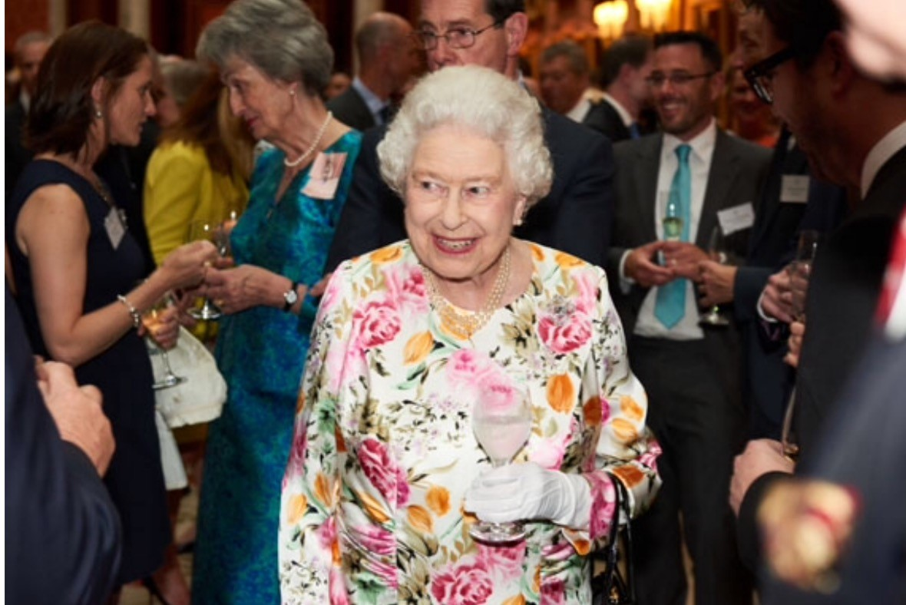
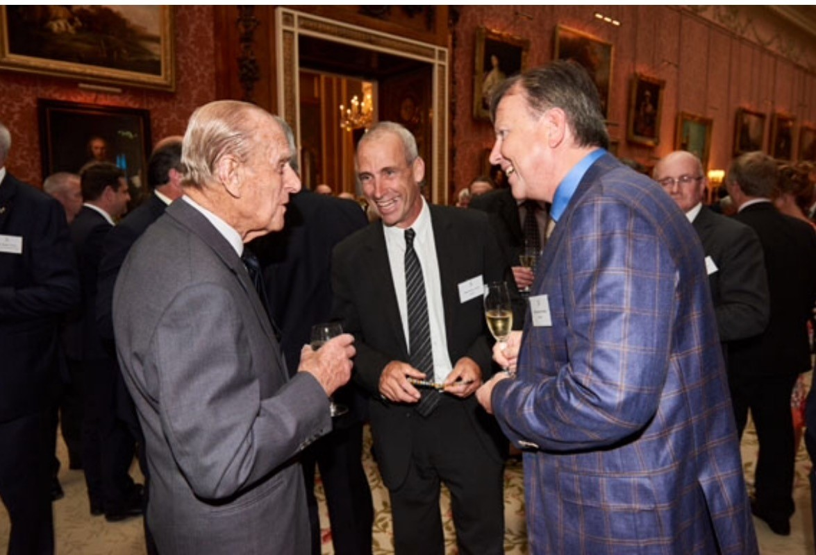
A modern, Royal Award with historic links
The most prestigious awards for UK businesses since 1965
Created by The Duke of Edinburgh for HM Queen Elizabeth II

Slide 3
Changing to The King's Awards for Enterprise
Last year, King Charles III continued Queen Elizabeth’s legacy by giving His Majesty’s name to prestigious awards
The name change reflects His Majesty The King’s desire to continue recognising and promoting outstanding business

Slide 4
Awards Background
Recognising and encouraging the outstanding achievements of UK businesses in the fields of:
Innovation
International Trade
Sustainable Development
Promoting Opportunity (through social mobility)
The UK is full of exciting and innovative businesses and The King’s Awards for Enterprise is a great way of celebrating their success.
Whether a small business with a great innovative product or service, or a larger company running an impressive social mobility programme, this award is a prestigious way to recognise your contribution to enterprise.

Slide 5
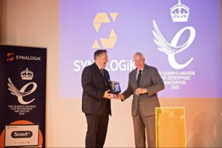
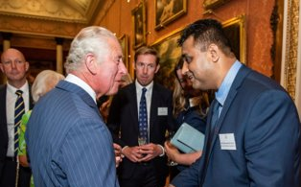
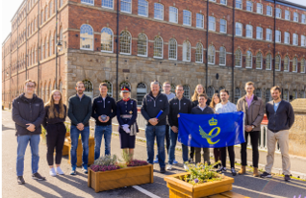
Benefits of receiving an Award
Use of the Royal Emblem for five years - this Royal seal of approval helps business get noticed, above and beyond the competition
Great boost to staff morale - the award is presented locally either by HM Lord-Lieutenants, Lieutenant Governors and sometimes by a Member of the Royal Family.
Media spotlight – recipients gain positive media coverage
Attend a Royal Reception hosted by His Majesty The King
Recipients have reported:
Increased sales and growth
Access to new clients and markets
Greater recognition on the global stage
Easier to attract and retain highly skilled staff

Slide 6
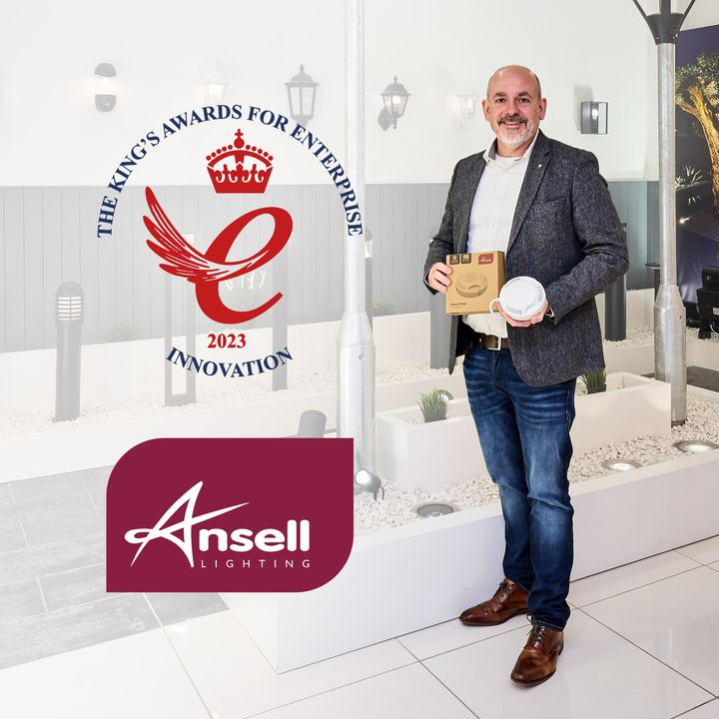
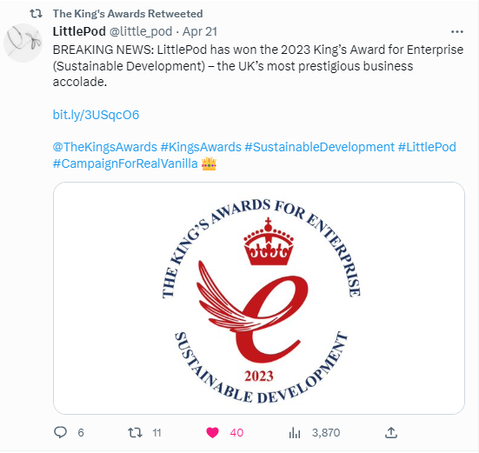
A few of the 148 Recipients from 2023

Slide 7
Awards Cycle
Open for new round of applications
(6 May)
Assessment of Entries (Sept-Oct)
Due Diligence checks (Nov)
4 Judging Panels (Jan-Feb)
Awards approved – PMAC, No.10 and HMK (March)
Awards Announced
(6 May)
Application process closes
(12 Sept)

Slide 8
Initial Eligibility Criteria
The organisation must:
Be based in the UK including the Channel Islands and Isle of Man
Have a good, continuous compliance record with HM Revenue and Customs or the relevant tax authority
Be a self-contained enterprise
Have at least two full-time employees or part-time equivalents
Demonstrate strong environmental, social and governance (ESG) practices

Slide 9
Application Guidance: Top Tips
Check your eligibility online – 10-minute questionnaire starts the process
Plan your responses by downloading the pdf application form
Use plain English – the assessors are coming to your initiative from scratch
Provide evidence of your achievements, qualitative and quantitative
Tell your own story with authenticity and passion – why do you stand out
Add 2 or more collaborators to your account – spread the work
Allow sufficient time – you’ll need to gather evidence, ask your accountant etc
Answer it once, answer it well – you can refer back to previous answers

Slide 10
Application Guidance Innovation
To apply for the Innovation Award, you must:
have an innovation that has not been sold before
have had your innovation available on the market for at least 2 years
have recovered all the investments made in your innovation or show that the innovation will recover its full costs in future
Show outstanding commercial success as a result of innovation from 2 up to 5 years
Your innovation should be in one of the following categories:
invention, design or production of goods
performance of services
marketing and distribution
after-sale support of goods or services
Your story:
What was the situation which led to your innovation?
What are the challenges you have overcome
Why is your innovation unique
How does your innovation benefit your business, customers and others
Applicants must now submit their most recent commercial success and not wind back to the pre-covid years
Notes:
if you have created a programme or innovation with another, you should submit your application and ask your partner org. to complete their own application

Slide 11
Application Guidance
To apply for the International Trade Award, you must:
have made a minimum of £100,000 in overseas sales in the first year of your entry and show year-on-year growth
prove that your organisation has achieved outstanding growth in overseas earnings relative to your business size and sector
prove steep year-on-year growth (without dips) in overseas sales over 3 years - or substantial year-on-year growth (without dips) over 6 years
Your story:
Why is penetration of a particular market an achievement? Eg. are you the first, leading, fastest growing exporter in this market?
Why is your performance better than that of competitors?
What challenges have effected your trade and how you overcame them?
Applicants must now submit their most recent commercial success and not wind back to the pre-covid years
International Trade

Slide 12
Application Guidance
To apply for the Promoting Opportunity Award you must be:
a business, charity, social enterprise or non for profit with a social mobility programme or intervention, or
a subsidiary of an organisation with a social mobility focus
You cannot apply if social mobility is the main focus of your organisation.
However, training providers or educational organisations can apply when making a joint application with another organisation, or if the social mobility initiative relates to their own workforce.
Your story:
Tell us how you have supported individuals or groups from disadvantaged backgrounds to improve their job skills and their chances of finding work. This includes doing one or more of the following, for at least 2 years:
providing work experience or careers advice
mentoring
offering interview and job-related training
making sure your recruitment process is open to everyone
.
Promoting Opportunity (through Social Mobility)
Notes:
if you have created a programme or innovation with another, you should submit your application and ask your partner org. to complete their own application

Slide 13
Application Guidance
To apply for the Sustainable Development Award, you must:
Show how you have achieved outstanding sustainable development for more than 2 years
Provide evidence of the benefits or positive outcomes of your actions or interventions
If you have a sustainable product or approach, you must also demonstrate a sustainable business strategy.
Your story
Tell us about any specific successes, such as developing an innovative new product or process delivering environmental benefits, or seeing sustainable development outcomes embedded in your organisation, supply chain or community.
It is important to demonstrate that your company and/or senior decision makers are leading the way in your sector or community and how they have overcome important challenges that are specific to your sector.
What are you doing to be sustainable, in particular, compared to your competitors?
How are you leading the way and influencing others to be more sustainable?
Link to the United Nations Sustainable Development Goals
Sustainable Development

Slide 14
How to apply
Almost all businesses (including non-profit) can apply
The application process is free
All applications must be made online
You may apply for more than one category
Applications for the 2024 King’s Awards for Enterprise open on 6 May until 1pm 12 September 2024
Eligibility criteria and more information on how to apply is here www.gov.uk/kings-awards-for-enterprise

Slide 15
Contact Us
kingsawards@businessandtrade.gov.uk
020 4551 0081
www.gov.uk/kings-awards-for-enterprise
@TheKingsAwards
linkedin.com/company/the-kings-awards-for-enterprise

Slide 16
Additional support
His Majesty’s Lieutenant-Governor
Is The King’s personal representative and presents Awards on His behalf
Contact details can be found via https://www.governmenthouse.gg/honours-awards/
Business support services
Guernsey Chamber of Commerce: https://guernseychamber.com/
Digital Greenhouse: https://digitalgreenhouse.gg/

